Slide 1


Ayham Shaheen
January 20, 2025

Slide 2

OUTLINE
Executive Summary
Introduction
Methodology
Results
Conclusion
Appendix

Slide 3
Executive Summary
In this capstone project, we will predict if the SpaceX Falcon 9 first stage will land successfully using several machine learning classification algorithms.
The main steps in this project include:
Data collection, wrangling, and formatting
Exploratory data analysis
Interactive data visualization
Machine learning prediction
Our graphs show that some features of the rocket launches have a correlation with the outcome of the launches, i.e., success or failure.
It is also concluded that decision tree may be the best machine learning algorithm to predict if the Falcon 9 first stage will land successfully.

Slide 4
Introduction
In this capstone, we will predict if the Falcon 9 first stage will land successfully. SpaceX advertises Falcon 9 rocket launches on its website with a cost of 62 million dollars; other providers cost upward of 165 million dollars each, much of the savings is because SpaceX can reuse the first stage. Therefore if we can determine if the first stage will land, we can determine the cost of a launch.
This information can be used if an alternate company wants to bid against SpaceX for a rocket launch.
The main question that we are trying to answer is, for a given set of features about a Falcon 9 rocket launch which include its payload mass, orbit type, launch site, and so on, will the first stage of the rocket land successfully?

Slide 5

Section 1

Slide 6
Methodology
Data collection
SpaceX API
Web scraping
Data Wrangling
Exploratory Data Analysis
Determine Training Labels
Exploratory Data Analysis (EDA)
Pandas and NumPy
SQL
Data visualization
Matplotlib and Seaborn
Folium
Dash
Machine learning prediction
Logistic regression
Support vector machine (SVM)
Decision tree
K-nearest neighbors (KNN)

Slide 7
Data Collection – SpaceX API
request rocket launch data from SpaceX API with the following URL:
spacex_url="https://api.spacexdata.com/v4/launches/past"
The API provides data about many types of rocket launches done by SpaceX, the data is therefore filtered to include only Falcon 9 launches.
Every missing value in the data is replaced the mean the column that the missing value belongs to.
We end up with 90 rows or instances and 17 columns or features.

Slide 8
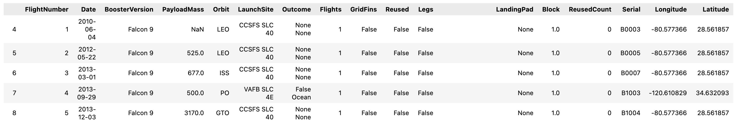
Data Collection – SpaceX API
The picture below shows the first few rows of the data:
GitHub URL:
https://github.com/AyhamShaheen/IBM-Data-Science-Capstone/blob/main/1-%20Spacex%20Data%20Collection%20API.ipynb

Slide 9

Data Collection – Web Scraping
The data is scraped from: https://en.wikipedia.org/w/index.php?title=List_of_Falcon_9_and_Falcon_Heavy_launches&oldid=1027686922
The website contains only the data about Falcon 9 launches.
We end up with 121 rows or instances and 11 columns or features.
The picture below shows the first few rows of the data:

Slide 10
Data Collection – Web Scraping
GitHub URL:
https://github.com/AyhamShaheen/IBM-Data-Science-Capstone/blob/main/2-%20SpaceX%20Data%20Collection%20with%20Web%20Scraping.ipynb

Slide 11
Data Wrangling
The data is later processed so that there are no missing entries, and categorical features are encoded using one-hot encoding.
An extra column called ‘Class’ is also added to the data frame. The column ‘Class’ contains 0 if a given launch is failed and 1 if it is successful.
at the end, we end up with 90 rows or instances and 83 columns or features.
GitHub URL:
https://github.com/AyhamShaheen/IBM-Data-Science-Capstone/blob/main/3-%20SpaceX%20Data%20wrangling.ipynb

Slide 12
EDA with Data Visualization
Exploring and Preparing Data:
perform Exploratory Data Analysis and Feature Engineering
Visualize the relationship between Flight Number vs. Payload Mass:
We see that as the flight number increases, the first stage is more likely to land successfully
Visualize the relationship between Flight Number vs. Launch Site:
explain the patterns
Visualize the relationship between Payload Mass vs. Launch Site:
we find for the VAFB-SLC launch Site there are no rockets launched for heavy payload mass(greater than 10000).
Visualize the relationship between success rate of each orbit type:
we find that ES-L1, GEO, HEO and SSO orbits have the highest success rates

Slide 13
EDA with Data Visualization
Visualize the relationship between FlightNumber and Orbit type:
We observe that in the LEO orbit, success seems to be related to the number of flights.
Conversely, in the GTO orbit, there appears to be no relationship between flight number and success
Visualize the relationship between Payload Mass and Orbit type:
With heavy payloads the successful landing or positive landing rate are more for Polar,LEO and ISS.
However, for GTO, it's difficult to distinguish between successful and unsuccessful landings as both outcomes are present
Visualize the launch success yearly trend:
you can observe that the success rate since 2013 kept increasing till 2020
GitHub URL :
https://github.com/AyhamShaheen/IBM-Data-Science-Capstone/blob/main/4-%20SpaceX%20EDA%20with %20Data%20Viz.ipynb

Slide 14
EDA with SQL
Display the names of the unique launch sites in the space mission
Display 5 records where launch sites begin with the string 'CCA’
Display the total payload mass carried by boosters launched by NASA (CRS)
Display average payload mass carried by booster version F9 v1.1
List the date when the first successful landing outcome in ground pad was achieved
List the names of the boosters which have success in drone ship and have payload mass greater than 4000 but less than 6000
List the total number of successful and failure mission outcomes

Slide 15
EDA with SQL
List the names of the booster_versions which have carried the maximum payload mass.
List the records which will display the month names, failure landing_outcomes in drone ship ,booster versions, launch_site for the months in year 2015
Rank the count of landing outcomes (such as Failure (drone ship) or Success (ground pad)) between the date 2010-06-04 and 2017-03-20, in descending order
GitHub URL :
https://github.com/AyhamShaheen/IBM-Data-Science-Capstone/blob/main/4-%20SpaceX%20EDA%20with %20SQL.ipynb

Slide 16
Build an Interactive Map with Folium
to find some geographical patterns about launch sites
Mark all launch sites on a map
Mark the success/failed launches for each site on the map
Calculate the distances between a launch site to its proximities
GitHub URL :
https://github.com/AyhamShaheen/IBM-Data-Science-Capstone/blob/main/6-%20SpaceX%20Interactive%20Visual%20Analytics%20with%20Folium.ipynb

Slide 17
Build a Dashboard with Plotly Dash
launch success count for all sites
the launch site with highest launch success ratio
Payload vs. Launch Outcome for all sites
GitHub URL :
https://github.com/AyhamShaheen/IBM-Data-Science-Capstone/blob/main/6-%20SpaceX%20DashApp.ipynb

Slide 18
Predictive Analysis (Classification)
Functions from the Scikit-learn library are used to create our machine learning models.
The machine learning prediction phase include the following steps:
Standardizing the data
Splitting the data into training and test data
Creating machine learning models, which include:
Logistic regression
Support vector machine (SVM)
Decision tree
K nearest neighbors (KNN)
Fit the models on the training set
Find the best combination of hyperparameters for each model
Evaluate the models based on their accuracy scores and confusion matrix

Slide 19
Predictive Analysis (Classification)
The results are split into 5 sections:
SQL (EDA with SQL)
Matplotlib and Seaborn (EDA with Visualization)
Folium
Dash
Predictive Analysis
In all the graphs that follow, class 0 represents a failed launch outcome while class 1 represents a successful launch outcome.
GitHub URL :
https://github.com/AyhamShaheen/IBM-Data-Science-Capstone/blob/main/6-%20SpaceX%20Machine%20Learning%20Prediction.ipynb

Slide 20

Section 2

Slide 21
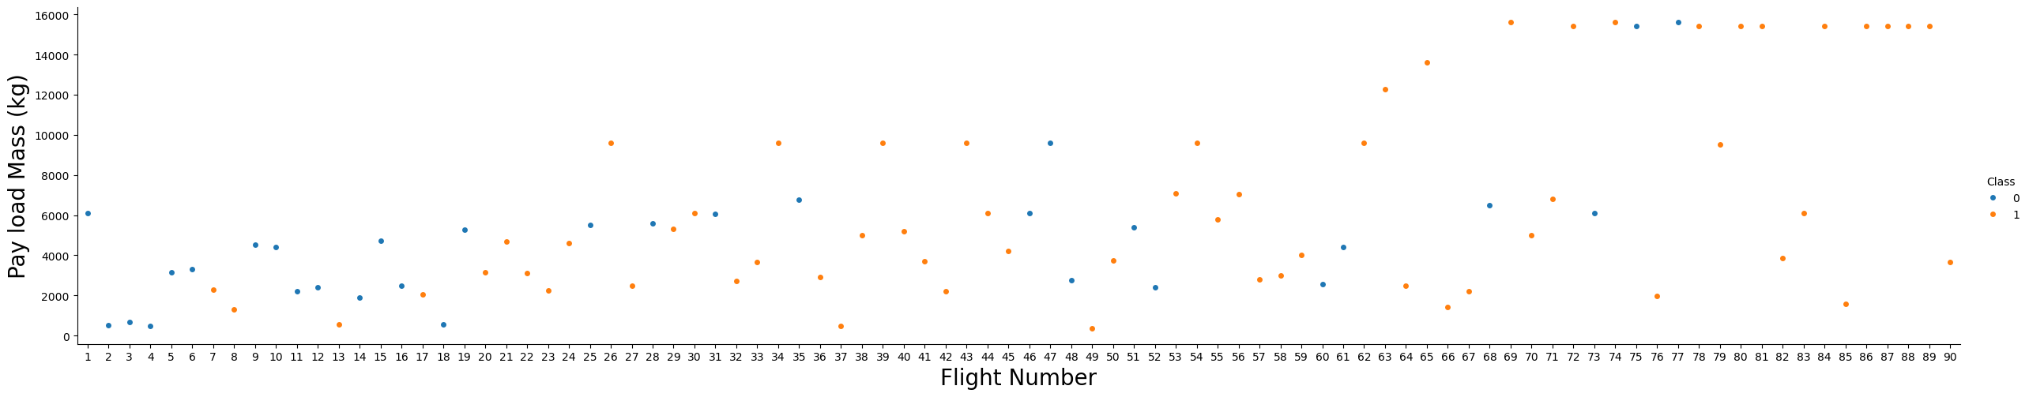
Flight Number vs. Payload Mass
to see how the Flight Number and Payload variables would affect the launch outcome

Slide 22
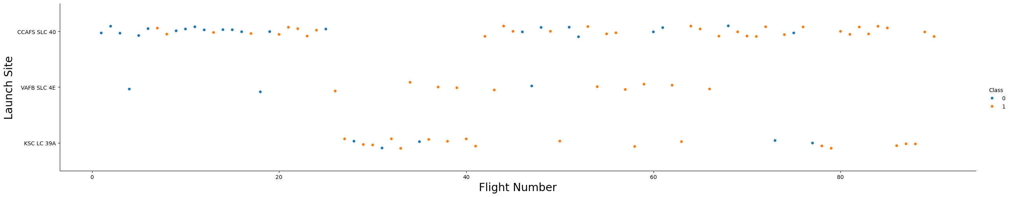
Flight Number vs. Launch Site
to show relationship between Flight Number and Launch Site

Slide 23
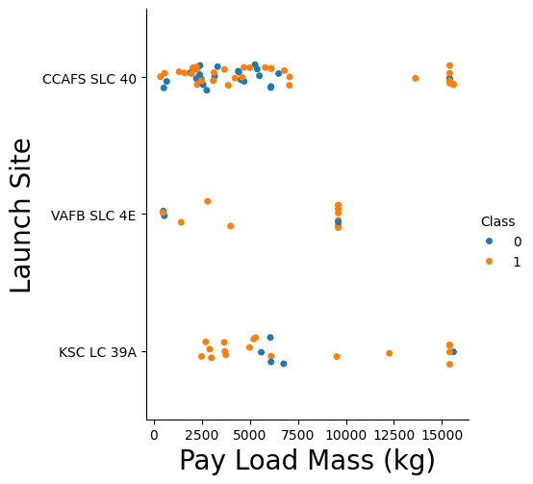
Payload vs. Launch Site
to visually check the relationship between Flight Number and Launch Site

Slide 24
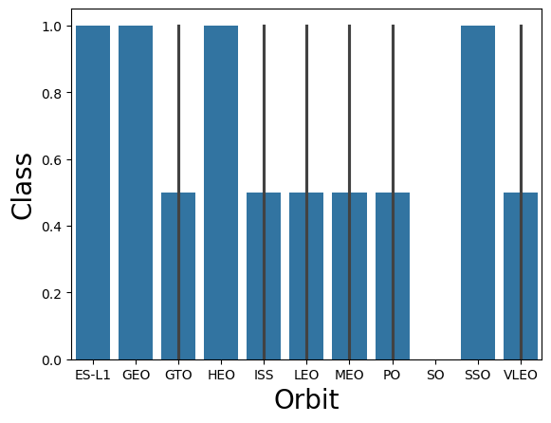
Success Rate vs. Orbit Type
to visually check if there are any relationship between success rate and orbit type

Slide 25
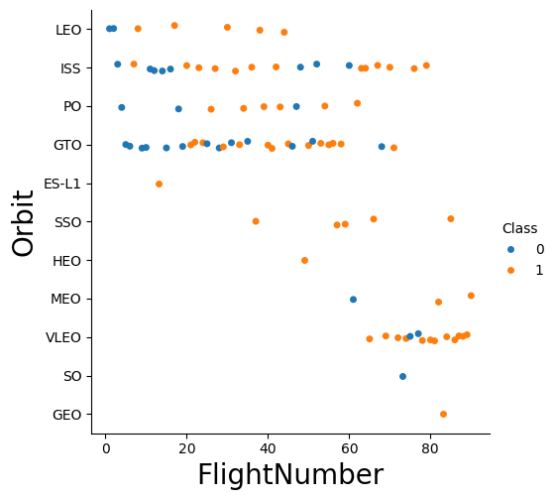
Flight Number vs. Orbit Type
to see if there is any relationship between Flight Number and Orbit type

Slide 26
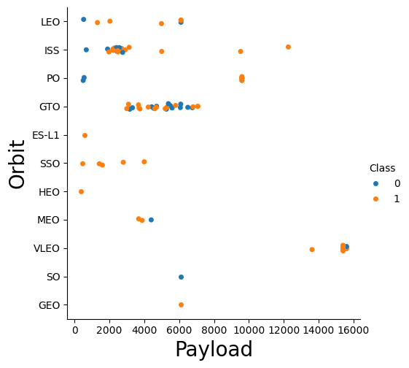
Payload vs. Orbit Type
to see if there is any relationship between Payload Mass and Orbit type

Slide 27
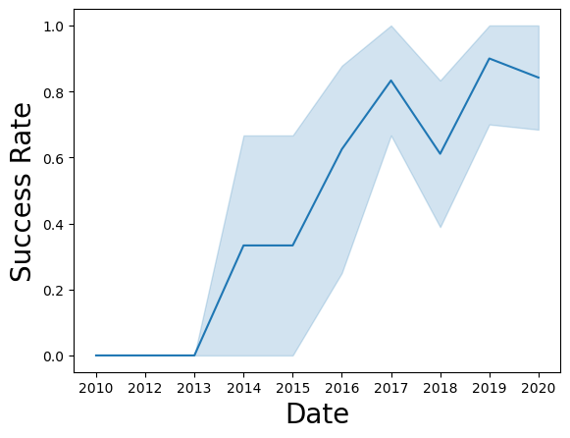
Launch Success Yearly Trend
to get the average launch success trend

Slide 28
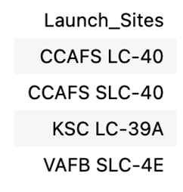
All Launch Site Names
The names of the unique launch sites in the space mission

Slide 29
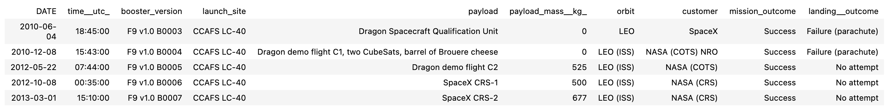
Launch Site Names Begin with 'CCA'
5 records where launch sites begin with ‘CCA’

Slide 30
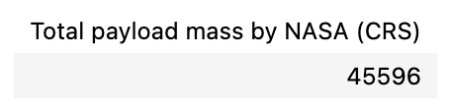
Total Payload Mass
The total payload mass carried by boosters launched by NASA (CRS)

Slide 31
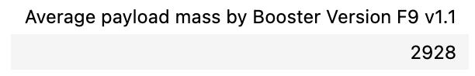
Average Payload Mass by F9 v1.1
The average payload mass carried by booster version F9 v1.1

Slide 32
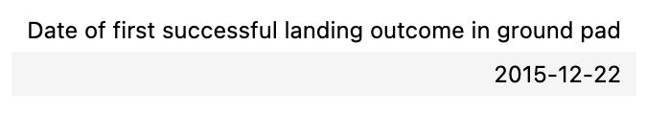
First Successful Ground Landing Date
The date when the first successful landing outcome in ground pad was achieved

Slide 33
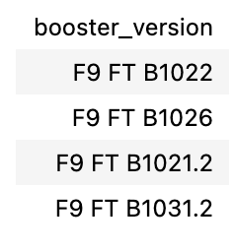
Successful Drone Ship Landing with Payload between 4000 and 6000
the names of boosters which have successfully landed on drone ship and had payload mass greater than 4000 but less than 6000

Slide 34
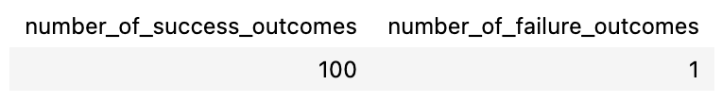
Total Number of Successful and Failure Mission Outcomes
the total number of successful and failure mission outcomes

Slide 35
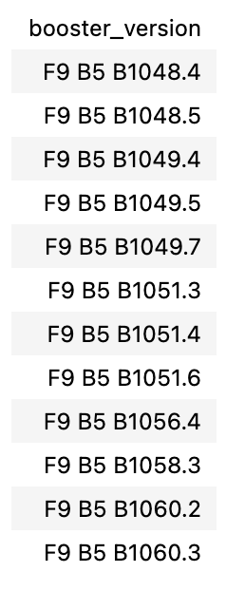
Boosters Carried Maximum Payload
the names of the booster which have carried the maximum payload mass

Slide 36
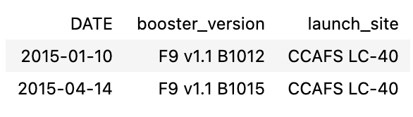
2015 Launch Records
the failed landing_outcomes in drone ship, their booster versions, and launch site names for in year 2015

Slide 37
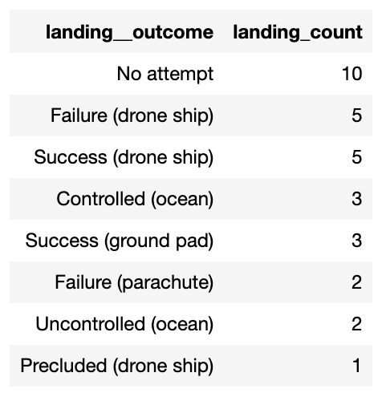
Rank Landing Outcomes Between 2010-06-04 and 2017-03-20
the count of landing outcomes (such as Failure (drone ship) or Success (ground pad)) between the date 2010-06-04 and 2017-03-20, in descending order

Slide 38

Section 3

Slide 39

All Launch Sites on Map

Slide 40
succeeded launches and failed launches for each site on map
If we zoom in on one of the launch site, we can see green and red tags.
Each green tag represents a successful launch while each red tag represents a failed launch

Slide 41
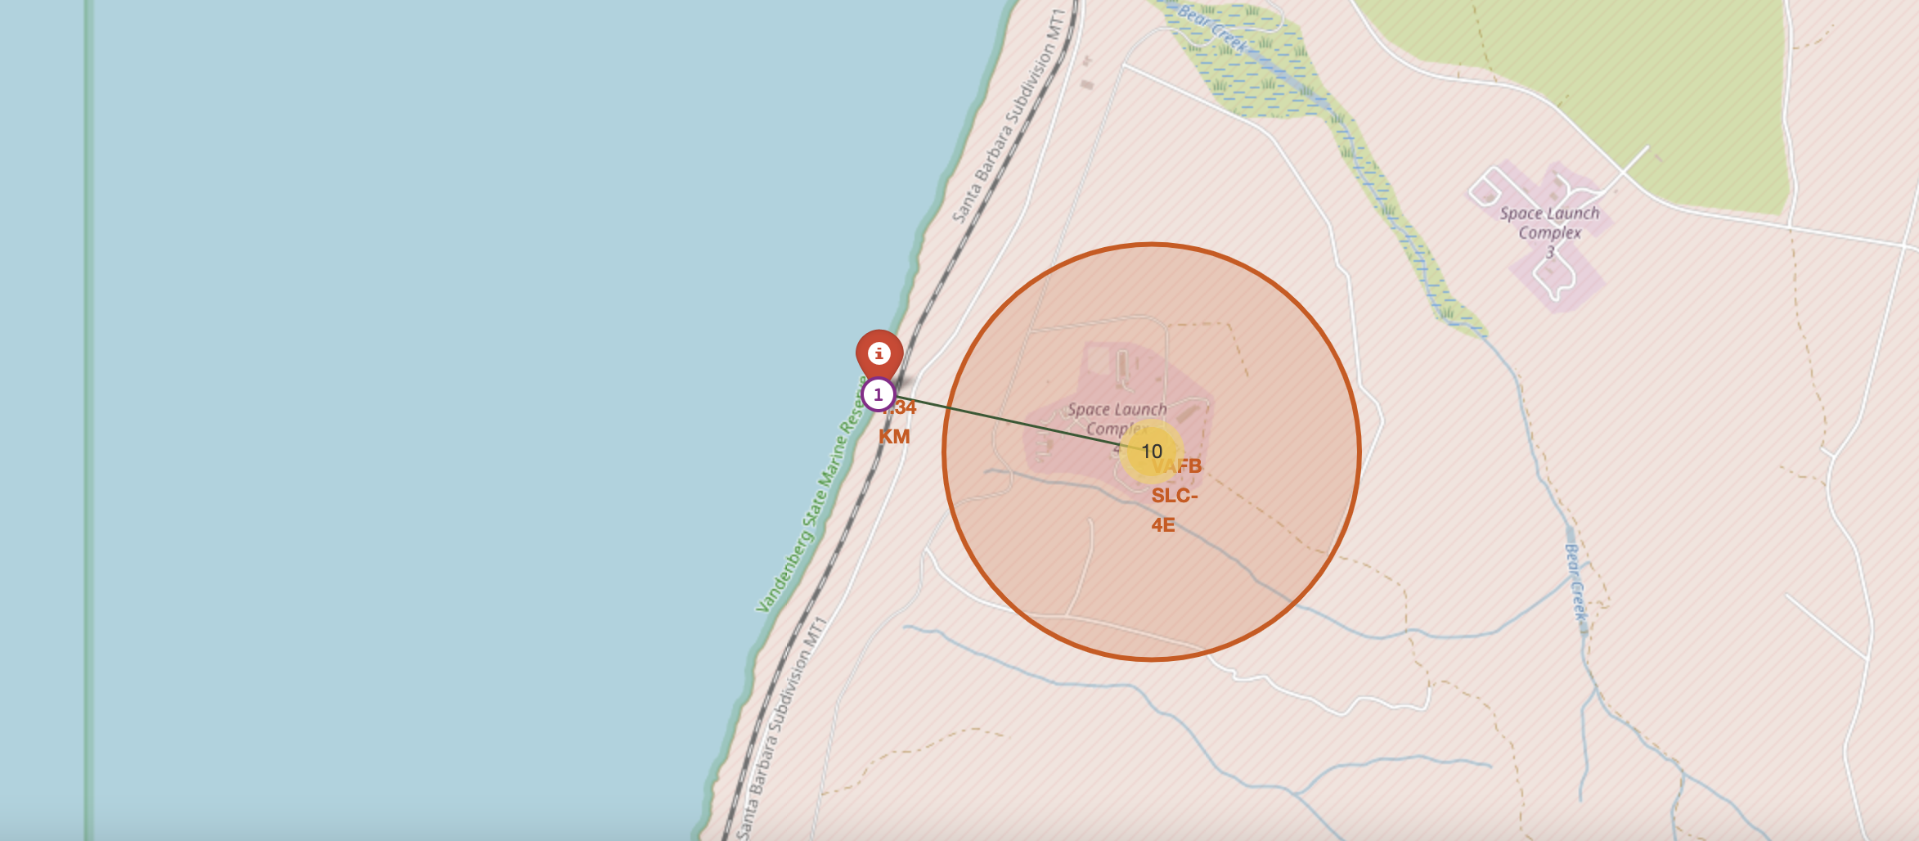
The distances between a launch site to its proximities
The distances between a launch site to its proximities such as the nearest city, railway, or highway
The picture below shows the distance between the VAFB SLC-4E launch site and the nearest coastline

Slide 42

Section 4

Slide 43
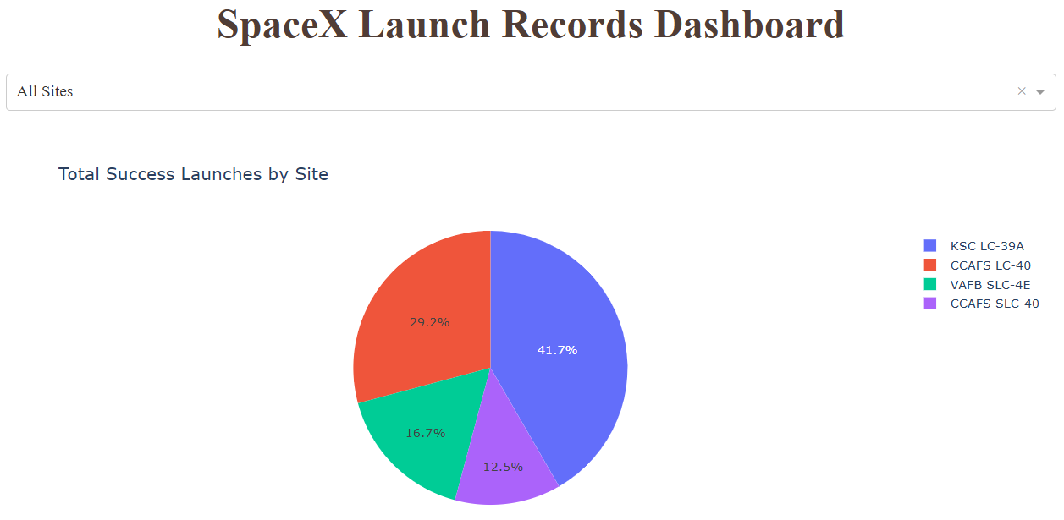
Dashboard
launch success count for all sites

Slide 44

Dashboard
the launch site with highest launch success ratio CCAFS LC-40
0 represents failed launches while 1 represents successful launches. We can see that 73.1% of launches done at CCAFS LC-40 are failed launches.

Slide 45
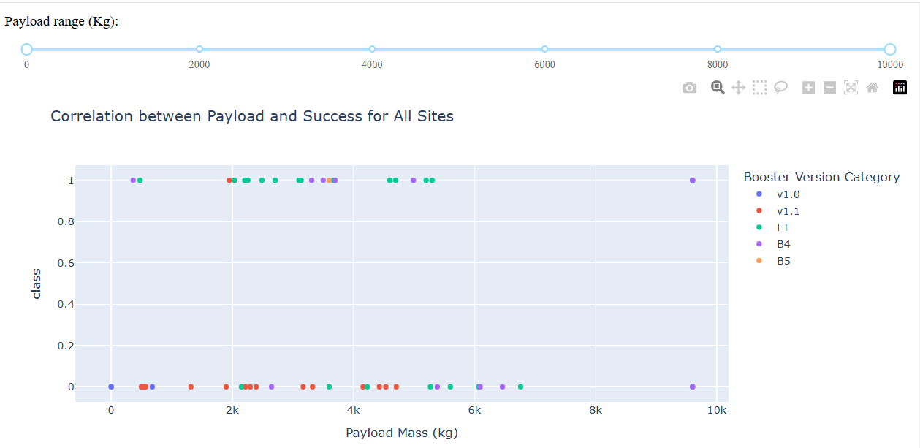
Dashboard
Payload vs. Launch Outcome scatter plot for all sites, with different payload selected in the range slider
Class 0 represents failed launches while class 1 represents successful launches.

Slide 46

Section 5

Slide 47
Classification Accuracy
Putting the results of all 4 models' side by side, we can see that they all share the same accuracy score and confusion matrix when tested on the test set.
Therefore, their GridSearchCV best scores are used to rank them instead.
Based on the GridSearchCV best scores, the models are ranked in the following order with the first being the best and the last one being the worst:
Decision tree (GridSearchCV best score: 0.8892857142857142)
K nearest neighbors, KNN (GridSearchCV best score: 0.8482142857142858)
Support vector machine, SVM (GridSearchCV best score: 0.8482142857142856)
Logistic regression (GridSearchCV best score: 0.8464285714285713)

Slide 48

Confusion Matrix
Decision tree
GridSearchCV best score: 0.8892857142857142
Accuracy score on test set: 0.8333333333333334

Slide 49
Conclusions
From the data visualization section, we can see that some features may have correlation with the mission outcome in several ways.
For example, with heavy payloads the successful landing or positive landing rate are more for orbit types Polar, LEO and ISS.
However, for GTO, we cannot distinguish this well as both positive landing rate and negative landing(unsuccessful mission) are both there here.
Therefore, each feature may have a certain impact on the final mission outcome.
The exact ways of how each of these features impact the mission outcome are difficult to decipher.
However, we can use some machine learning algorithms to learn the pattern of the past data and predict whether a mission will be successful or not based on the given features.

Slide 50








Appendix

Slide 51


